Slide 1
Stars and Stellar Nucleosynthesis
Philip Adsley padsley@tamu.edu
Texas A&M University
Department of Physics & Astronomy
Cyclotron Institute

Slide 2
Outline (all days)
What are stars and how do they work?
Nucleosynthesis in stars
Going from nuclear data to thermonuclear reaction rates – an experimentalist’s guide

Slide 3
Outline (today)
What are stars and how do they work?
What is the question we are trying to answer when we ask “what is the origin of the elements?”? (very meta)
The lives and deaths of stars
Nuclear burning in stars
This is not complete – I’m trying to give an outline but I probably leave out more than I include!

Slide 4
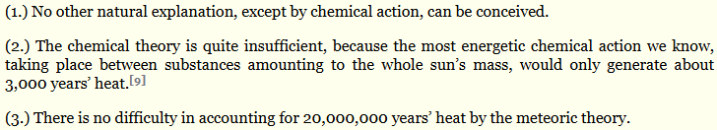
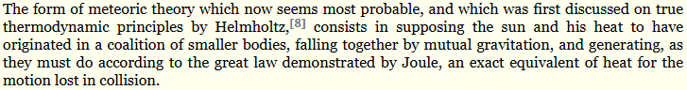
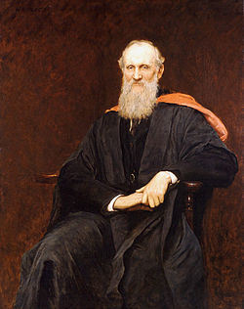

What are stars and how do they work?
Stars are balls of gas hot and dense enough to cause nuclear fusion in their cores
Engines converting mass into energy
How did we learn that this is the origin of the heat from stars?
1862: The Baron Kelvin of Largs (yes, that Kelvin) concluded that chemical processes cannot generate enough energy for the Sun to keep burning (based on coal)
Concluded that meteor infall was the cause of the continued heating of the Sun

Slide 5

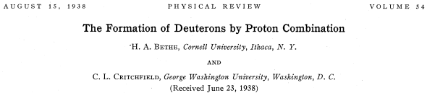
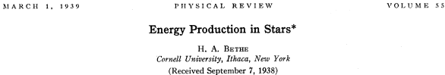
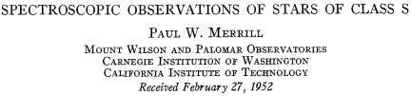
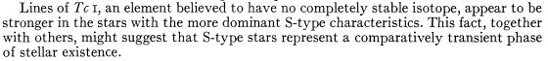
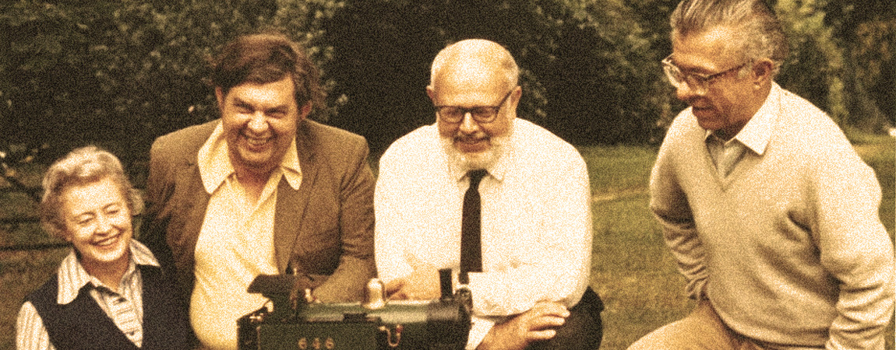
What are stars and how do they work?
1868: helium spectral lines (discovery of this element!)
1938: hydrogen burning (pp chains and CNO cycles) proposed
1952: first direct evidence of continuing nuclear reactions in stars (Tc absorption lines in stellar spectra)
1957: B²FH – Burbidge, Burbidge, Fowler and Hoyle (and Cameron) review the available literature and add observations and lab reaction studies
I left out Weizsacker because it’s in German

Slide 6
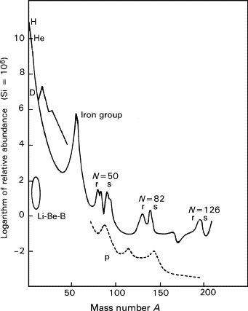
What is the origin of the elements?
What questions are we trying to answer?
I propose:
Why do we see certain patterns in the elements in the universe?
What does this pattern of elements tell us about the connection between nuclear physics and stars?
Encyclopedia of Spectroscopy and Spectrometry
1999, Pages 359-367

Slide 7
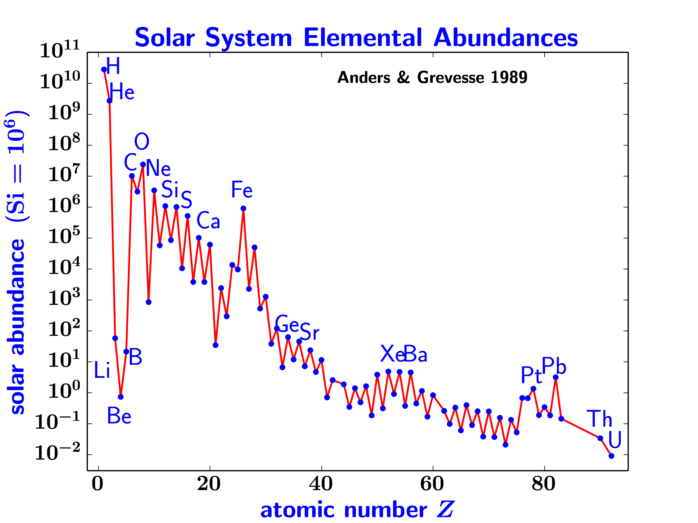
What is the origin of the elements?
What questions are we trying to answer?
I propose:
Why do we see certain patterns in the elements in the universe?
What does this pattern of elements tell us about the connection between nuclear physics and stars?

Slide 8
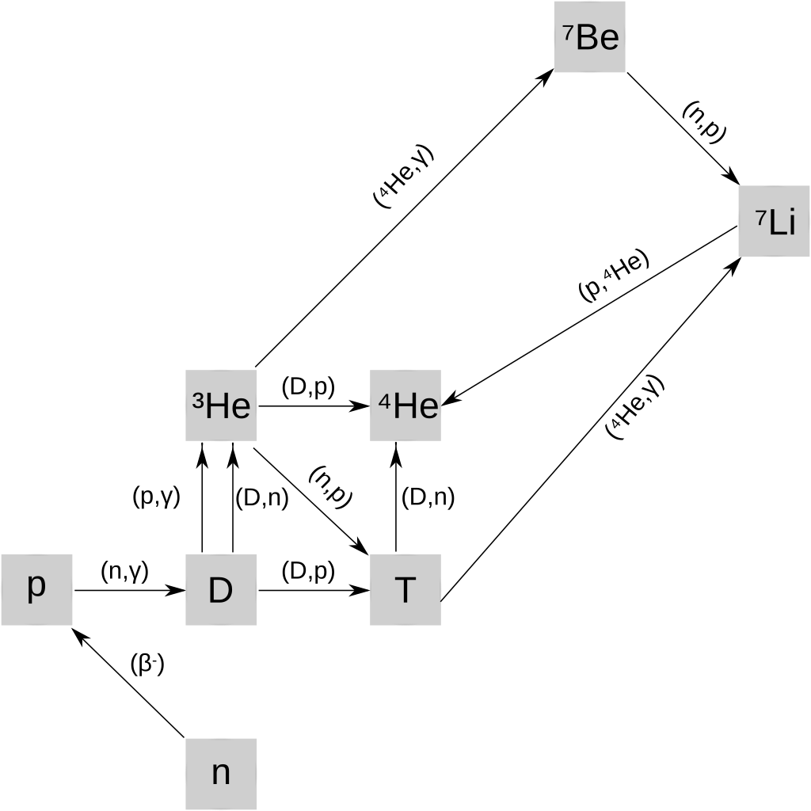
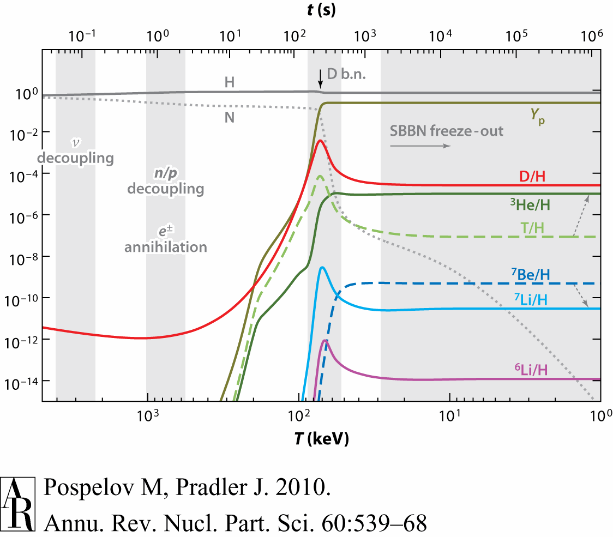
The Big Bang
In the beginning:
Matter cools after the Big Bang
Produce hadrons (protons+neutrons)
Can form the first nuclei but don’t have long and can’t get beyond A=7

Slide 9
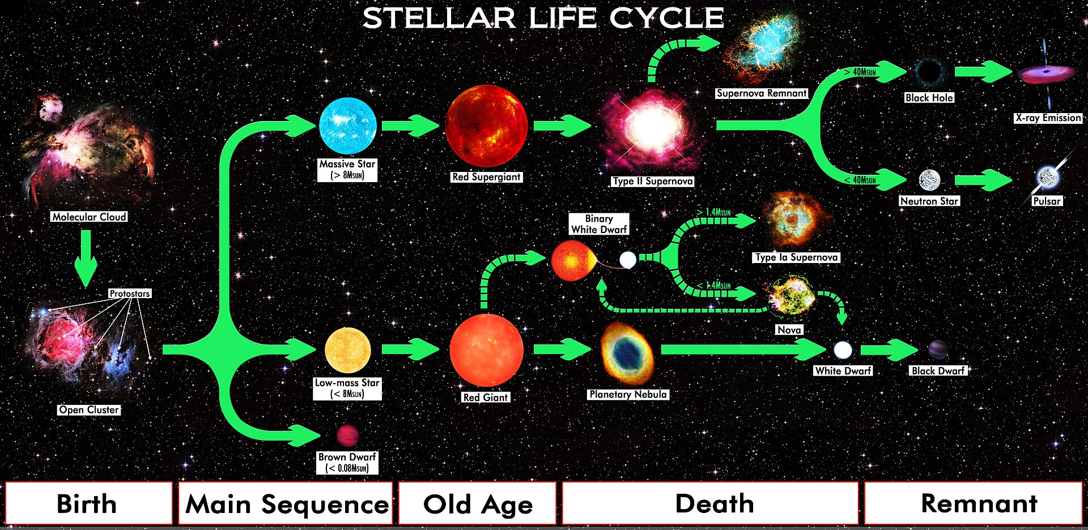
The lives of others stars
By R.N. Bailey - Own work, CC BY 4.0, https://commons.wikimedia.org/w/index.php?curid=59672008

Slide 10



By R.N. Bailey - Own work, CC BY 4.0, https://commons.wikimedia.org/w/index.php?curid=59672008
The lives of others stars
All stars follow a similar basic pattern
Collapse of cloud of gas – heating
Eventually hot and dense enough to cause fusion to start
Burn burn burn burn burn
Run out of fuel and die

Slide 11
By R.N. Bailey - Own work, CC BY 4.0, https://commons.wikimedia.org/w/index.php?curid=59672008
The lives of others stars
What (who?!) decides how a star lives and dies?
Mass – biggest determining factor
Metalicity – how much !(hydrogen and helium) is in the star
Rotational velocity – can cause mixing but not (to my knowledge) so important for life/death

Slide 12
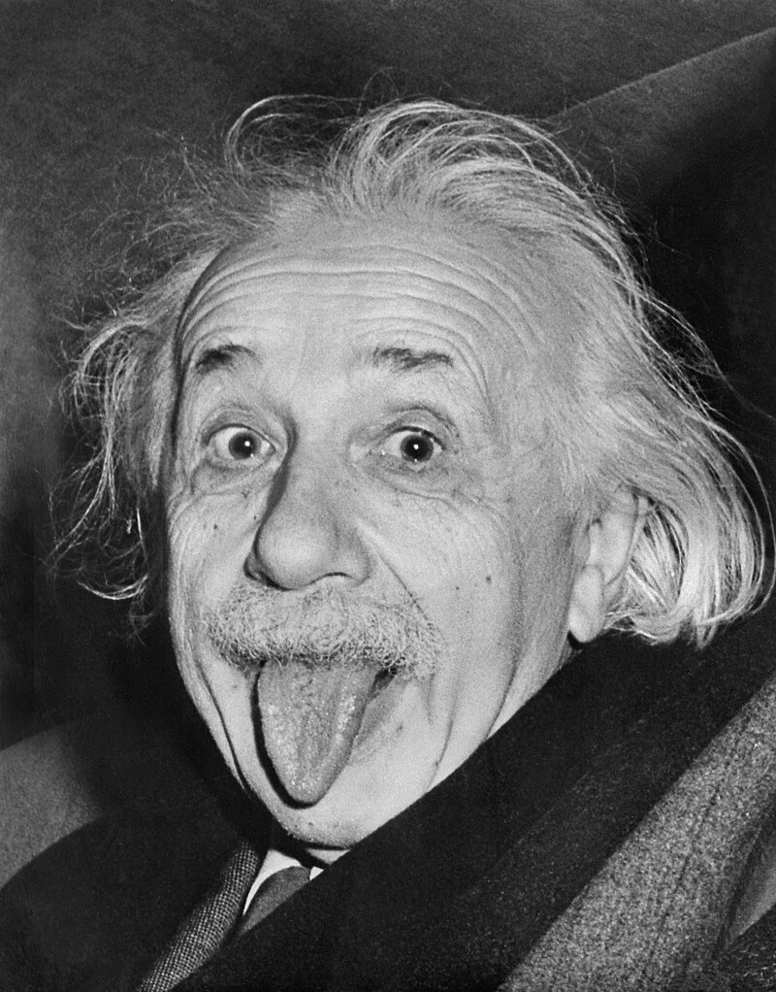
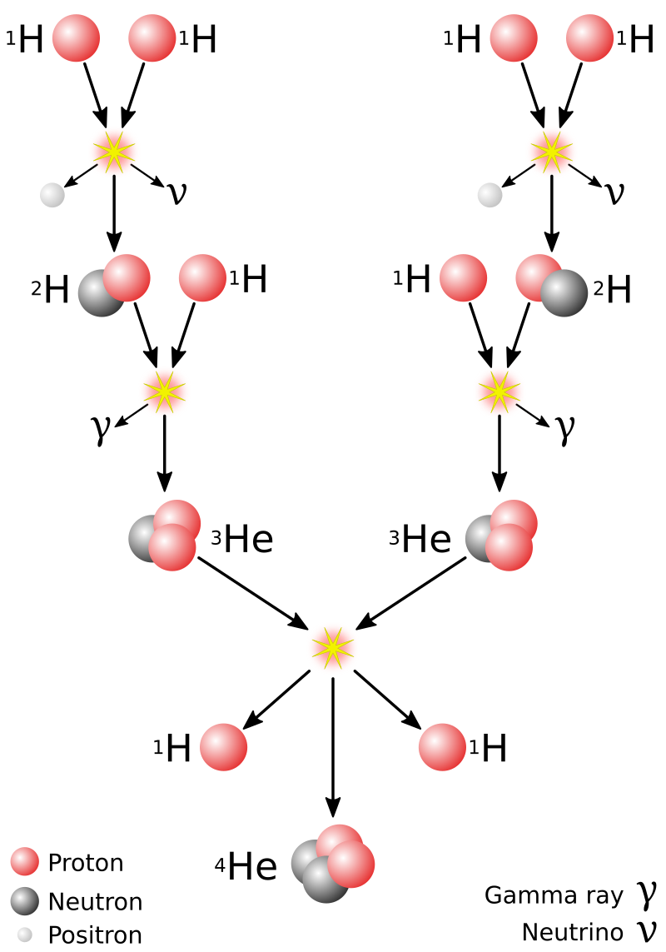
By International News Service - https://www.3dnews.ru/assets/external/illustrations/2013/10/10/767653/3.jpg, Public Domain, https://commons.wikimedia.org/w/index.php?curid=155774692
Stellar burning processes
Need processes that convert mass to energy
Simplest reaction:
Proton + proton -> deuteron + positron + electron neutrino + 0.42 MeV
Mass of a proton = 938.28 MeV/c²
Electron = 0.511 MeV/c²
Deuteron = 1875.62 MeV/c²
E = mc²
By Sarang - Own work, Public Domain, https://commons.wikimedia.org/w/index.php?curid=51118538

Slide 13
Stars are cold and other confusing things
I’m going to talk about this in more detail in lecture 3 but…
Stars are cold (from a nuclear-physics perspective)
Boltzmann k = 86.2 keV/GK
Coulomb barrier
V_{c} = 1.44Z₁Z₂/R MeV
R is around 1.3(A₁^{1/3} + A₂^{1/3}) fm
Coulomb barrier
V(r)
Classically forbidden region – quantum tunnelling
In the nucleus

Slide 14
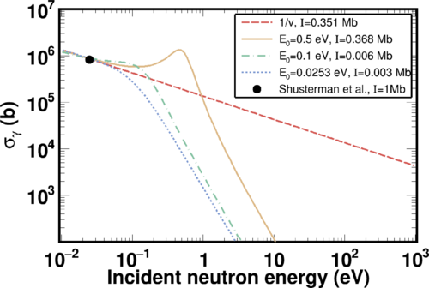
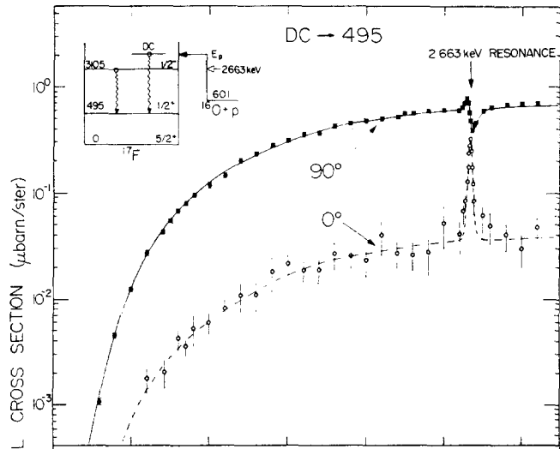
What does this mean for stellar burning?
Reactions involving neutrons, if available, are easier than ones with charged particles (but neutrons aren’t stable!)
In general, lower atomic number reactants require lower temperatures for the reactions to “go”
As temperatures rise, more reactions are possible
No cross section suppression at low energy for neutrons
Stamatopoulos++
PRC 111 034613 (also a PRL)
Cross sections for charged particles drops WORSE than exponentially with energy
Rolfs Nuclear Physics A 217 29-70 (1973)

Slide 15
Hydrogen burning comes first
Simplest stellar burning is conversion of hydrogen to helium
Process is often extremely slow
pp fusion is a weak interaction process
Once we have other nuclei made, strong/EM dominated processes with some weak decays
By Sarang - Own work, Public Domain, https://commons.wikimedia.org/w/index.php?curid=51118538

Slide 16
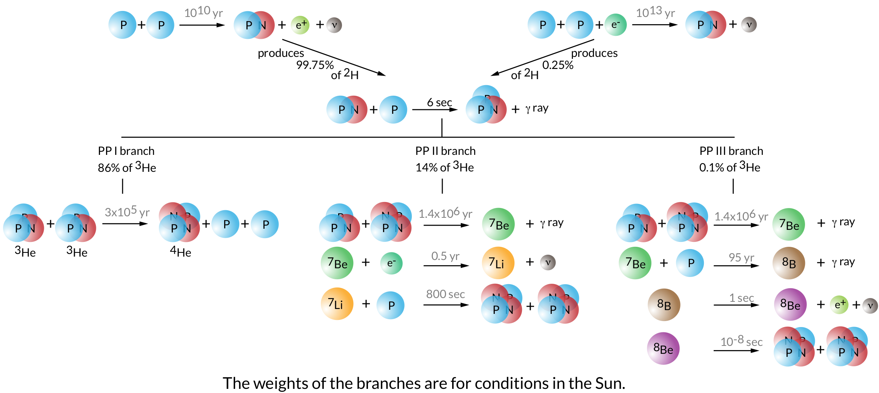
Frank Timmes website

Slide 17
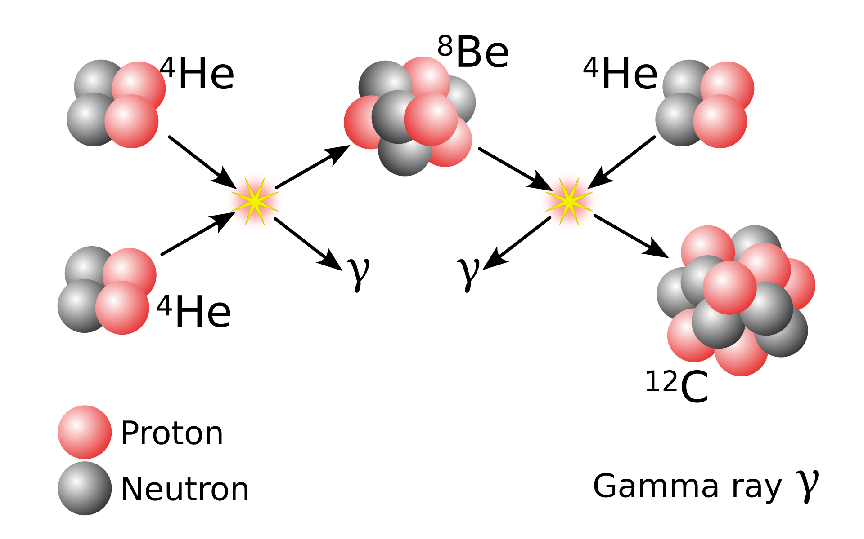
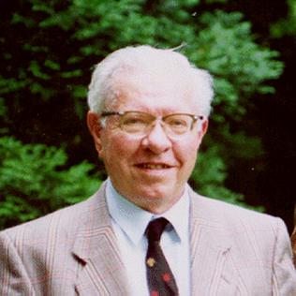
What to do with helium?
At helium we are stuck
⁴He+proton -> ⁵Li (unbound)
⁴He+neutron -> ⁵He (unbound)
⁴He+⁴He -> ⁸Be (unbound)
How can we make heavier elements?
Combine 3 ⁴He into ¹²C
“Triple α” process
Wikipedia ☺

Slide 18

The CNO cycles
Now we have ¹²C! (I’m lying slightly…)
Can have other forms of hydrogen burning take place
Catalytic process
Series of proton captures and positron decays
Convert 4 protons into ⁴He and energy

Slide 19
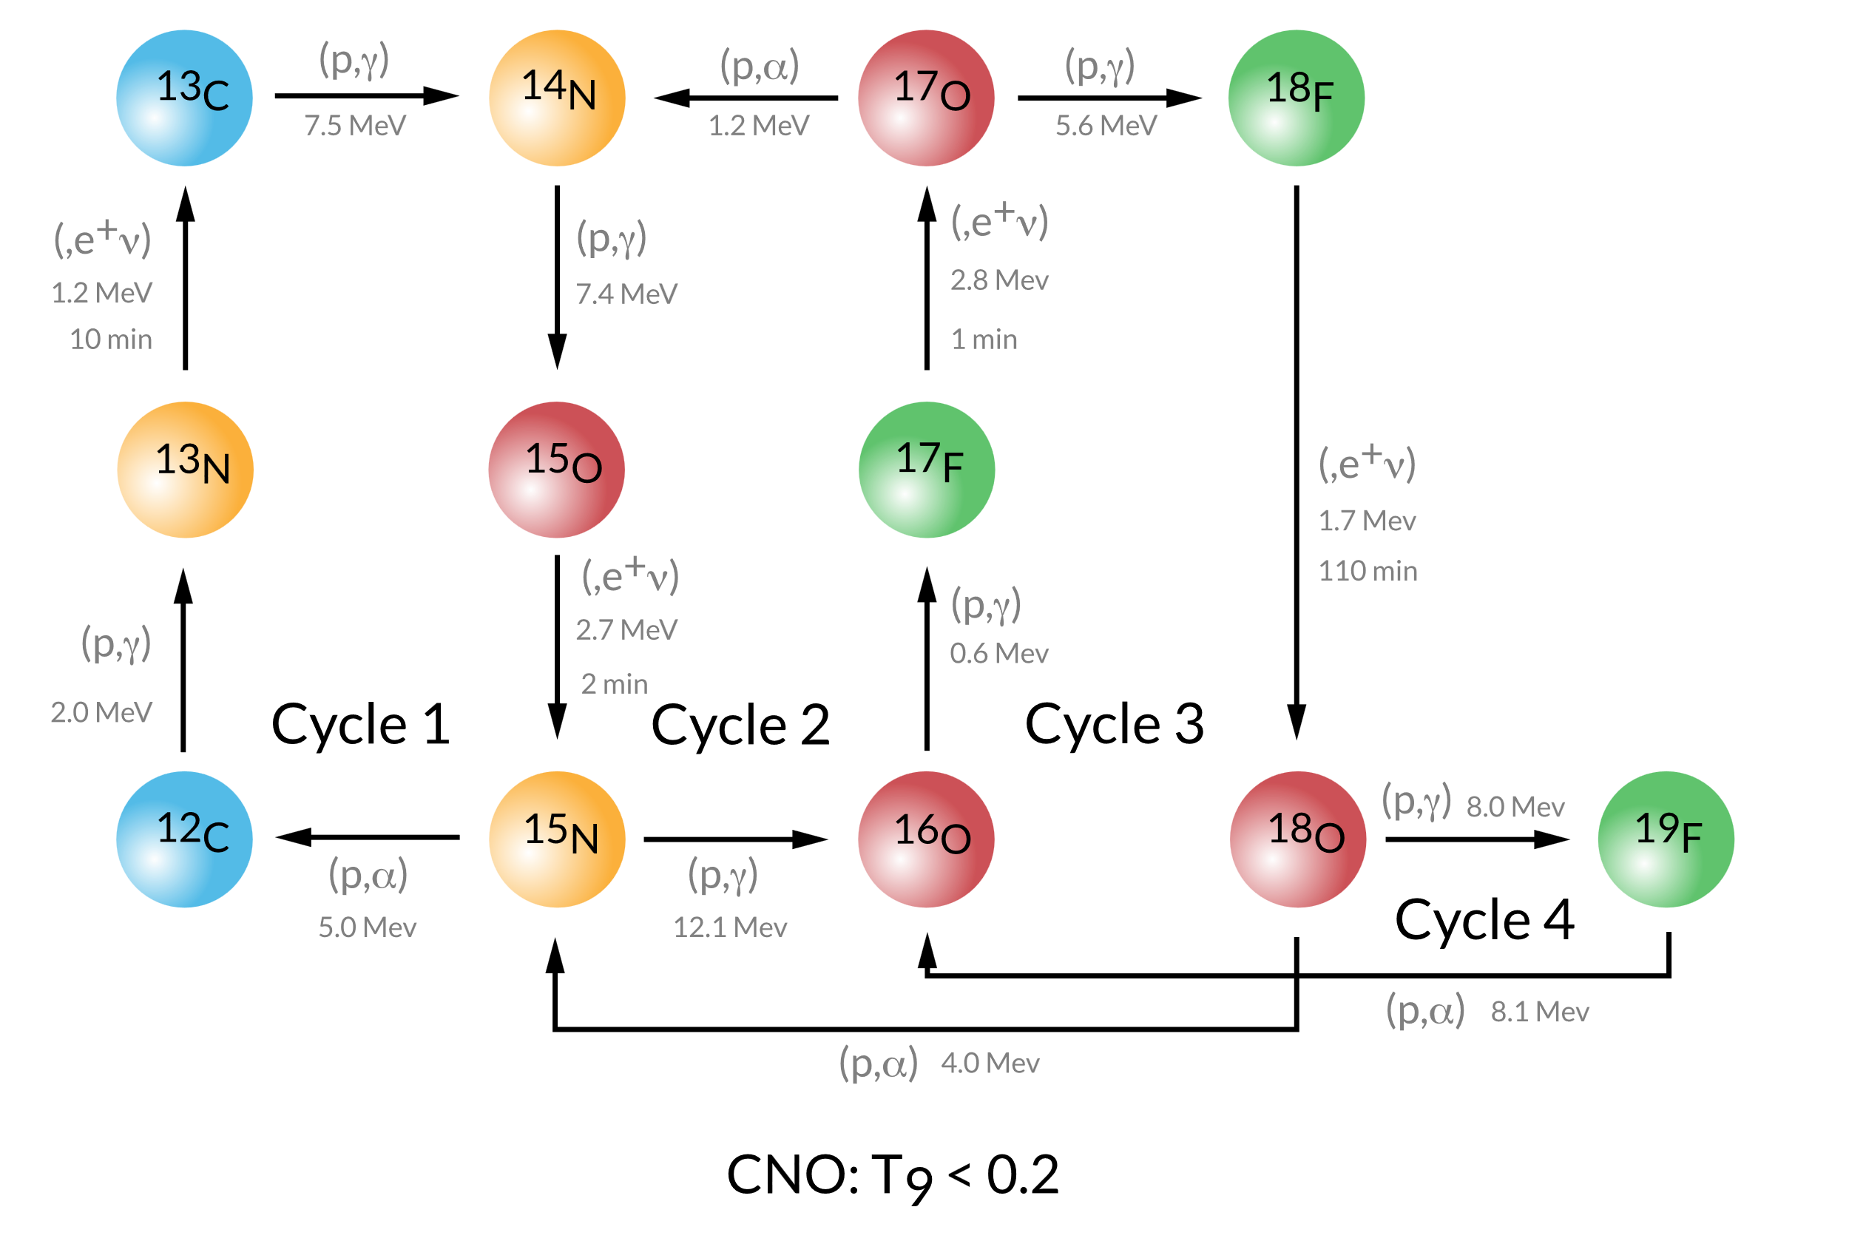
The CNO cycles
Frank Timmes website

Slide 20
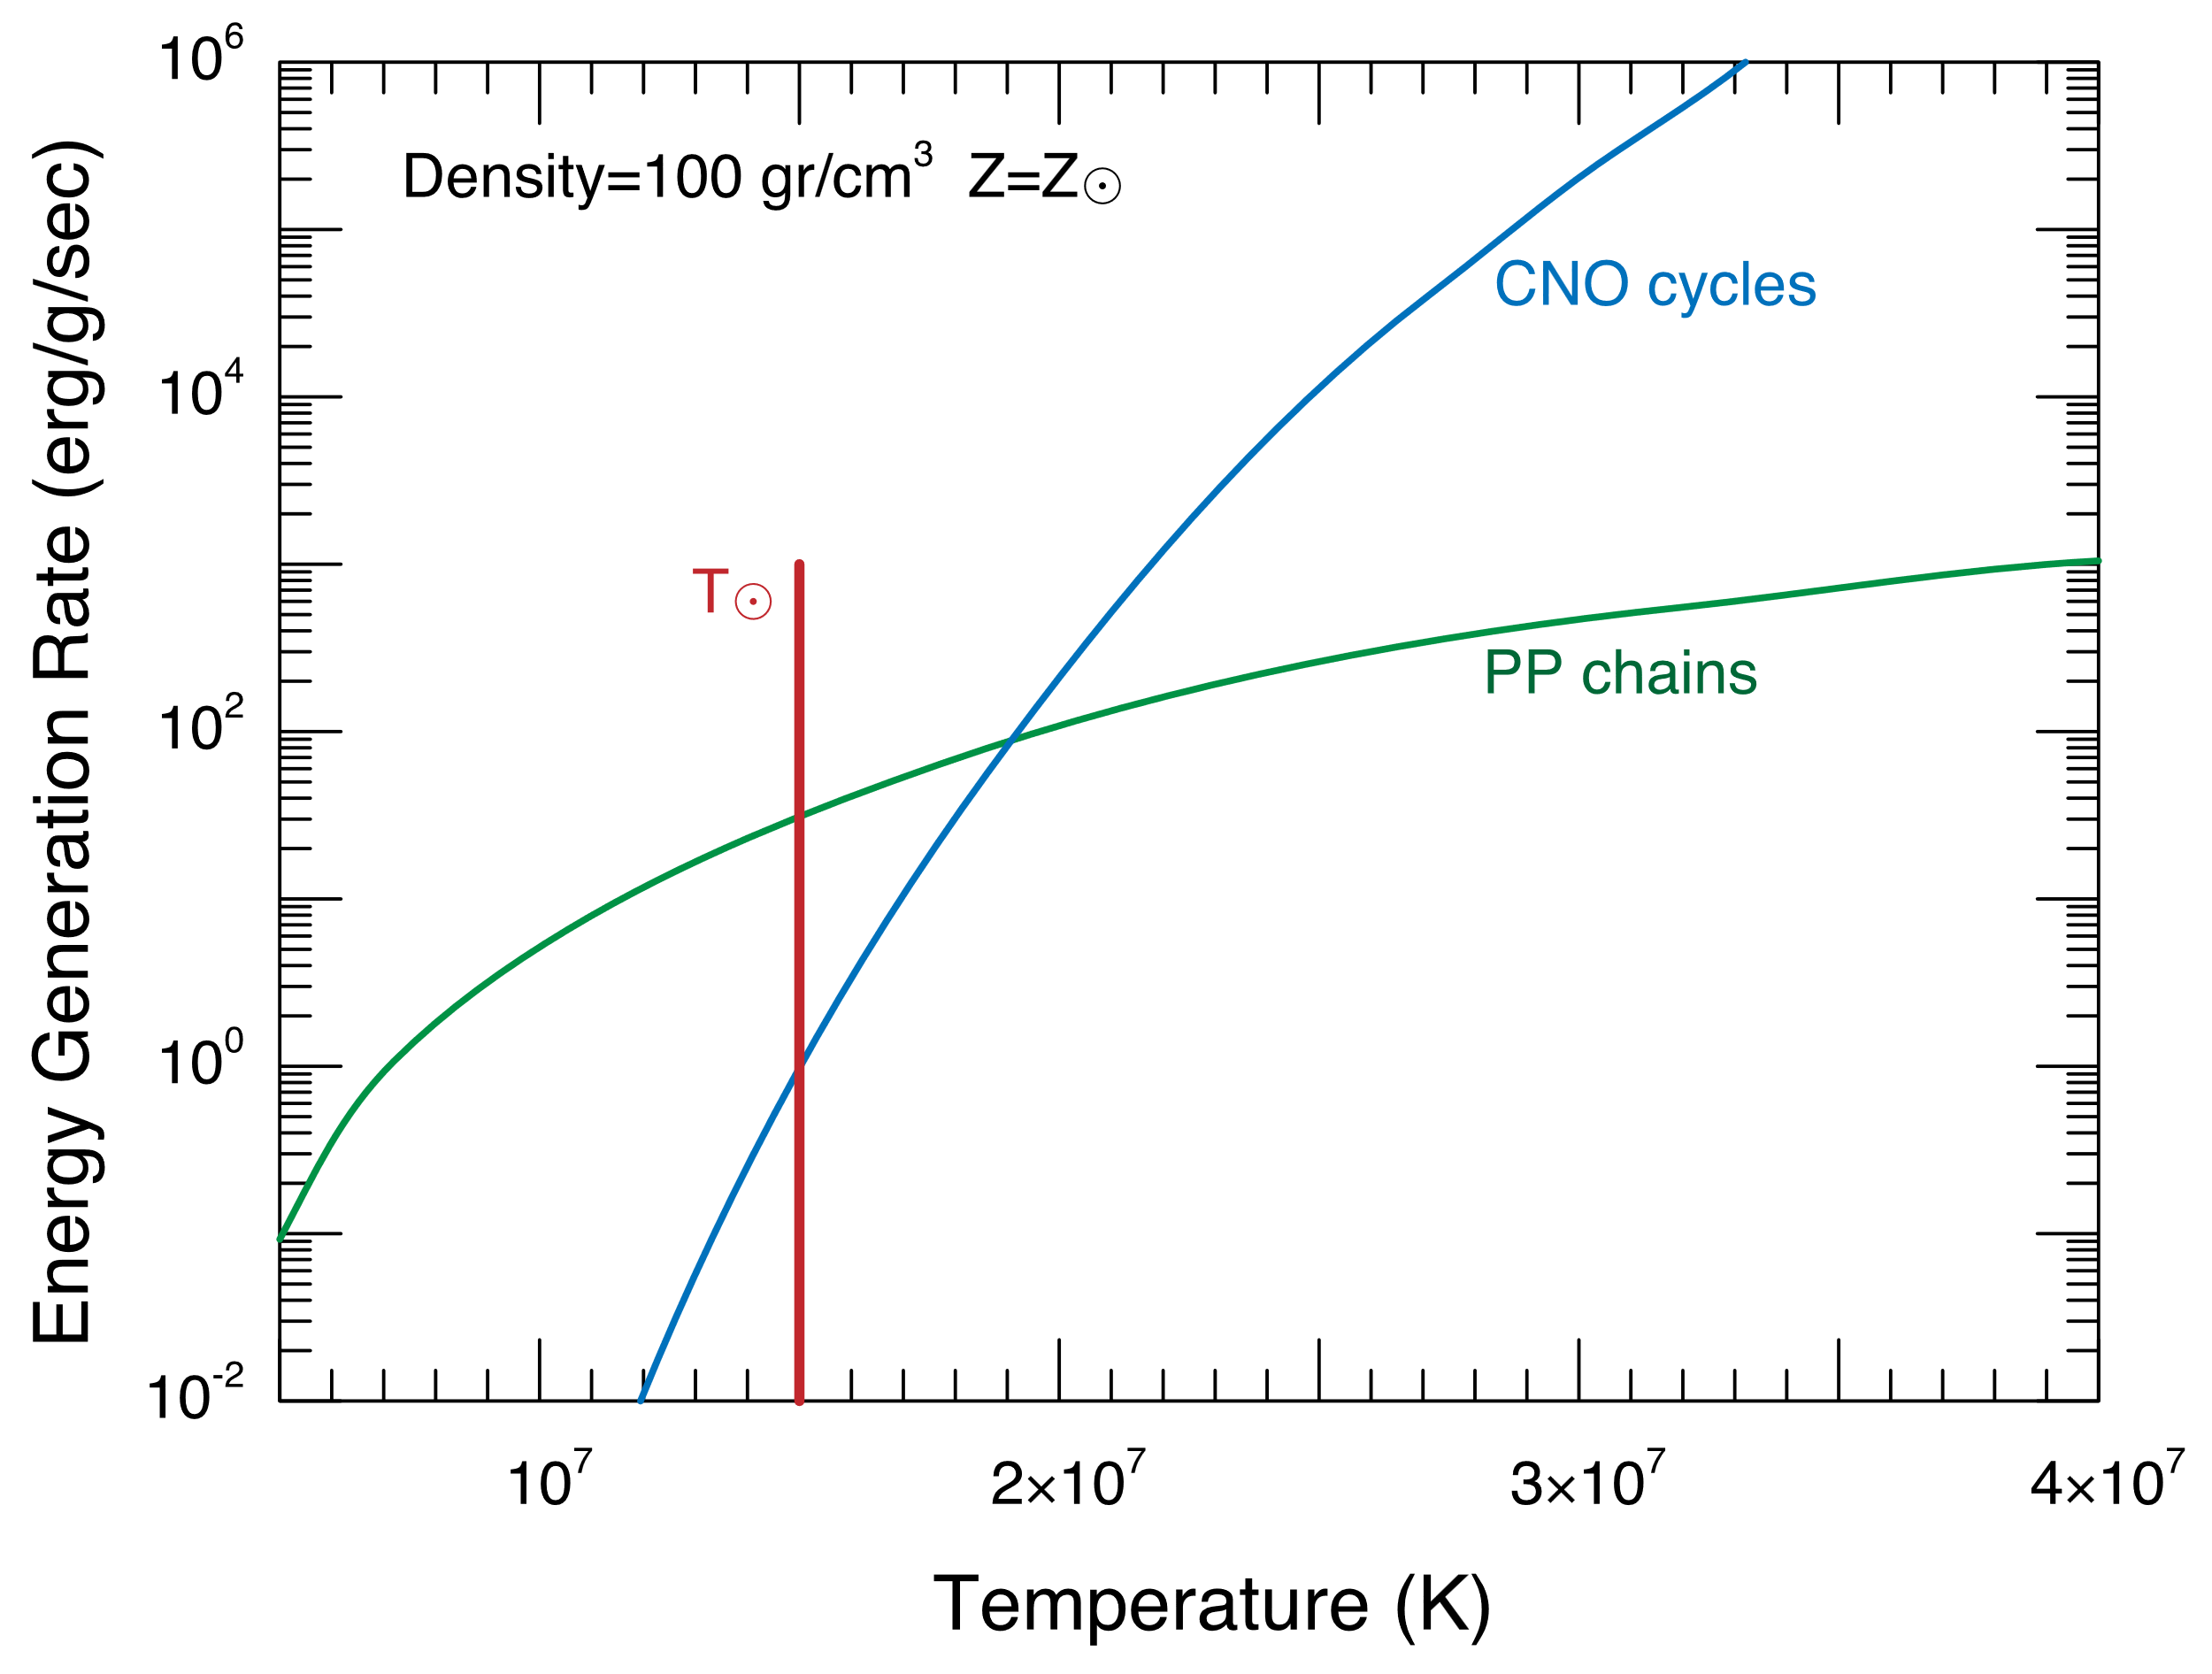
What now?
Frank Timmes website
Our star can burn hydrogen into helium
Which process depends on:
Temperature (need higher T to overcome Coulomb barrier for hydrogen burning)
Metallicity (if I don’t got carbon, I can’t use it to burn hydrogen)

Slide 21
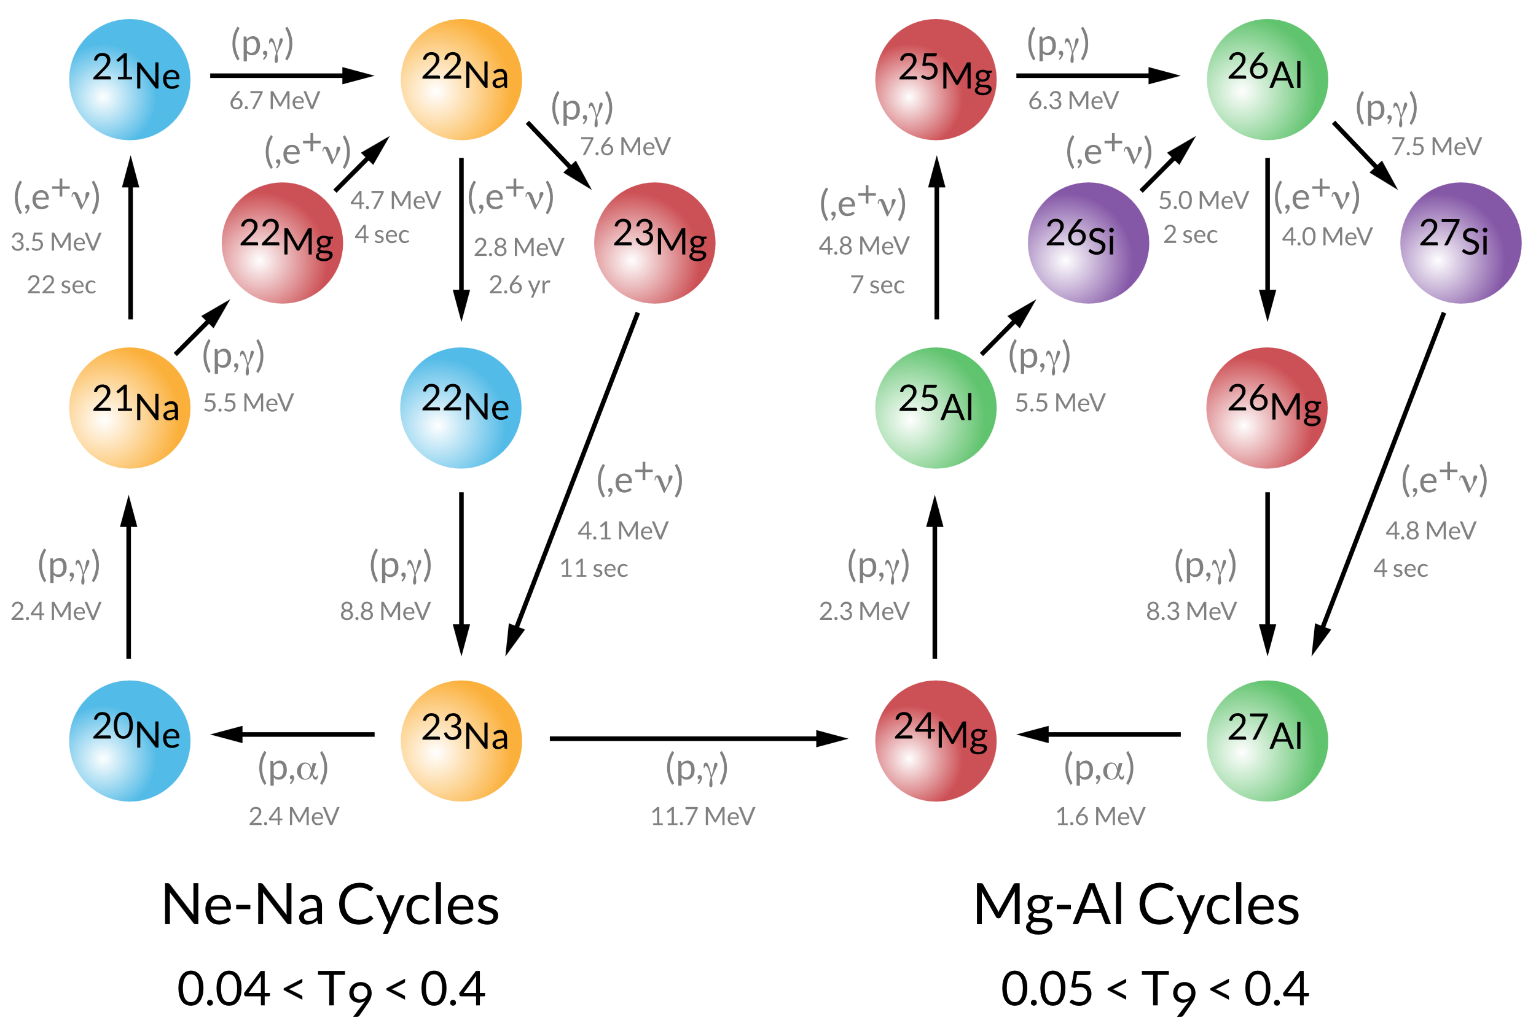
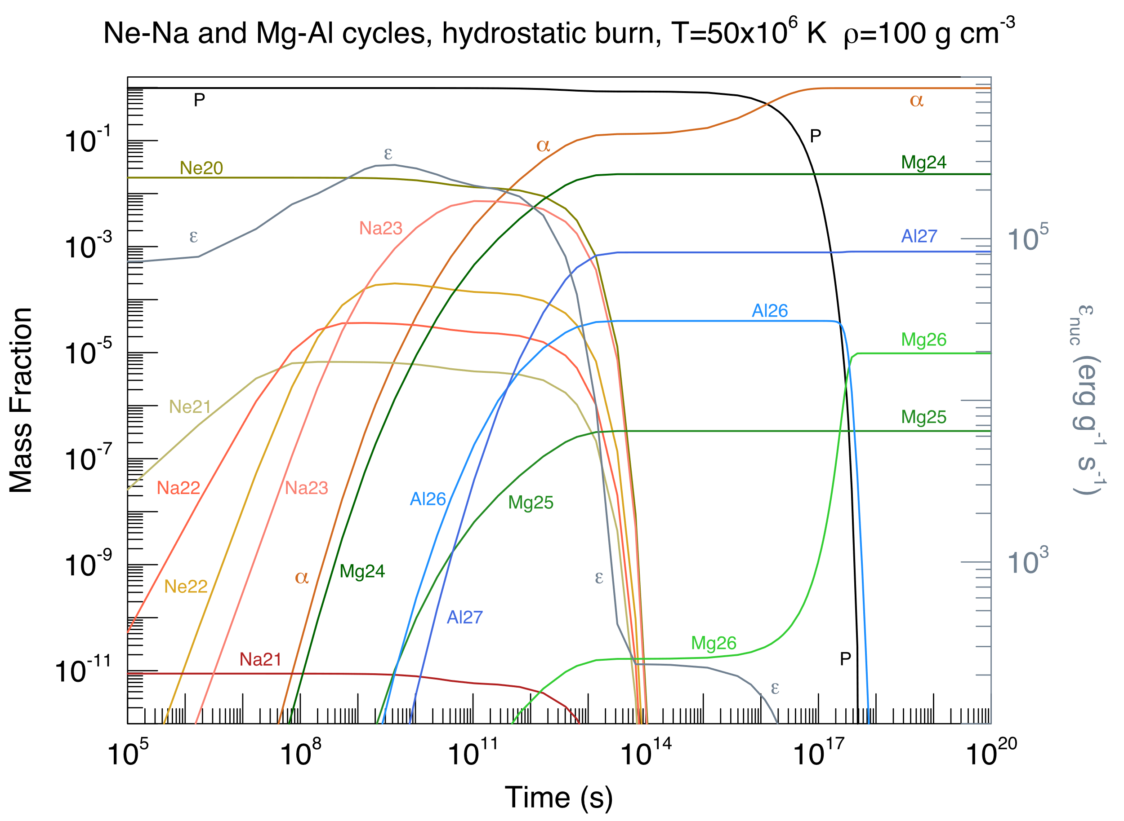
Continued hydrogen burning
Hydrogen burning will continue to drive energy generation until hydrogen in the core is consumed
Depending on mass: other hydrogen burning can happen
NeNa and MgAl during Hot Bottom Burning
Affects nucleosynthesis but not thermodynamics/stellar structure
Some open questions here: do we need A≥20 nuclei available for NeNa + MgAl or can ¹⁹F(p,γ)²⁰Ne provide a link?
Frank Timmes website

Slide 22
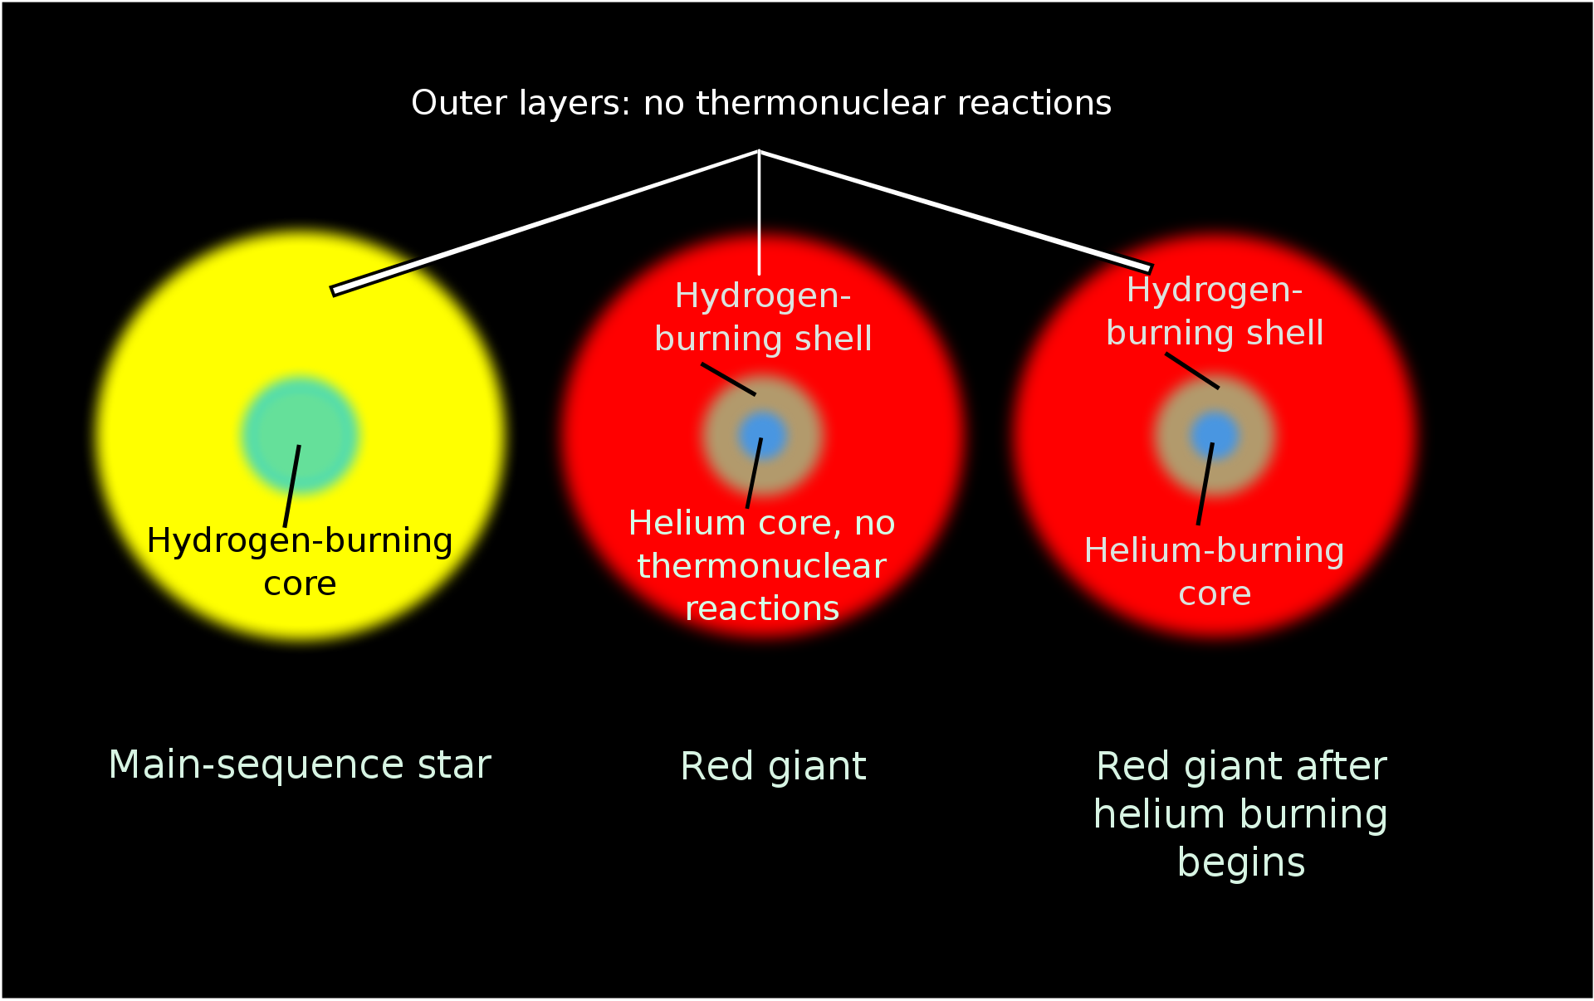
The end of hydrogen burning
Hydrogen burning will continue to drive energy generation until hydrogen in the core is consumed
When we don’t have hydrogen left, there’s no energy generation in the core – it contracts
Core contracting – heats up enough and ignites helium burning
If the star is too small – doesn’t heat up enough and instead supported by electron degeneracy pressure
By RicHard-59 - Own work, based on this., CC BY-SA 3.0, https://commons.wikimedia.org/w/index.php?curid=30534795

Slide 23
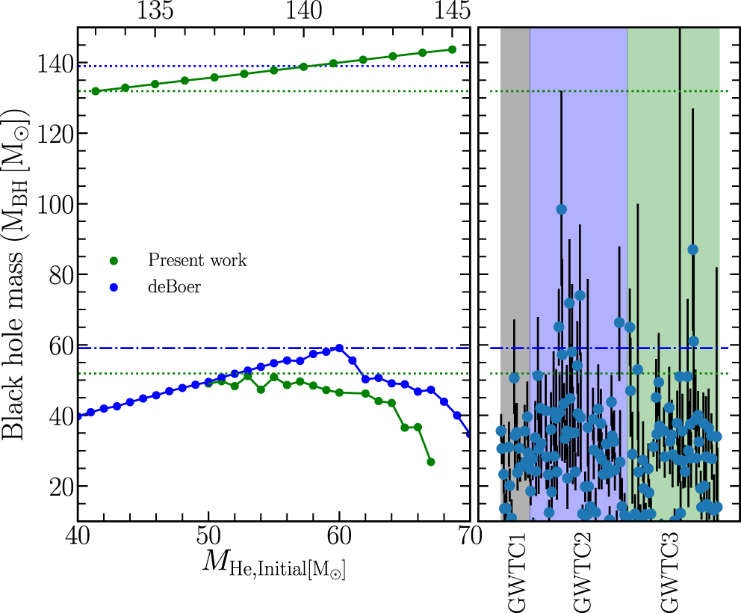
Helium burning
Hydrogen burning will continue to drive energy generation until hydrogen in the core is consumed
Now mostly burning ¹²C into ¹⁶O by capturing an α particle
The Holy Grail of Nuclear Astrophysics – ¹²C(α,γ)¹⁶O
Can continue making α-conjugate nuclei by capture reactions
Helium reactions with leftover CNO material ¹³C, ¹⁴N VERY important – will discuss tomorrow
⁴He into ¹²C by triple α process (Wikipedia)
ApJ 945 Shen++

Slide 24
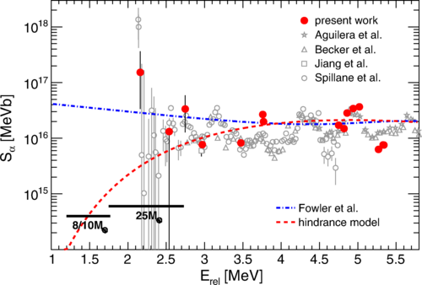
Late-stage capitalism nuclear burning
Eventually run out of helium
Again, contract the core and heat up
Activate carbon burning ¹²C+¹²C
Various exit channels (α,p,n,γ) and make various different nuclei
Also injecting light nuclei into these systems can cause more reactions!
Fruet++
PRL 124 192701

Slide 25
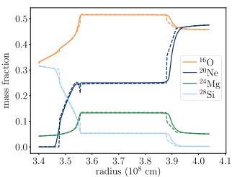
Late-stage capitalism nuclear burning
Eventually run out of carbon!!
Got a core made of ¹⁶O, ²⁰Ne, ²³Na and ²⁴Mg
Clearly the next stage is to fuse ¹⁶O?
Not so – the temperature becomes so high that ²⁰Ne releases α particles which cause reactions
“Neon burning”
Georgy++
MNRAS 531 4293 (2024)
It’s hot down here, the ²⁰Ne is all destroyed
Convective region, neon being destroyed, making oxygen and magnesium, magnesium being converted into silicon

Slide 26
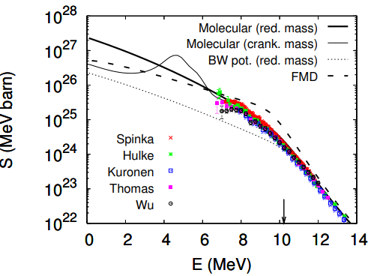
Late-stage capitalism nuclear burning
Eventually run out of neon
Now can activate ¹⁶O+¹⁶O
Again, produce many light ions which cause more reactions
Seriously, there are so many reaction channels open – and maybe resonances which could enhance the reaction rate
At higher temperatures, ¹⁶O(γ,α)¹²C rather than oxygen fusion takes over
Diaz-Torres PLB 652 255

Slide 27
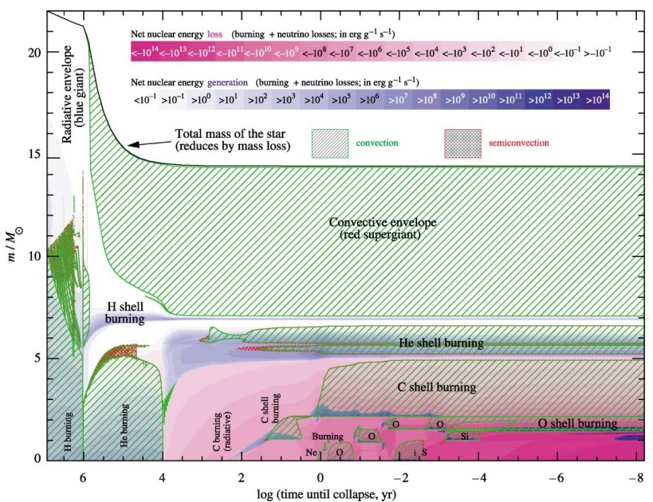
Late-stage capitalism nuclear burning
Truran + Heger
Eventually run out of oxygen
Left with a core with lots of ²⁸Si and ³²S
The Coulomb barrier for fusion of these systems is too high to overcome
Photodisintegration of weakly bound systems and use these light ions to drive nucleosynthesis
21 hours
1/3 of a second
3.65 days
30 seconds

Slide 28
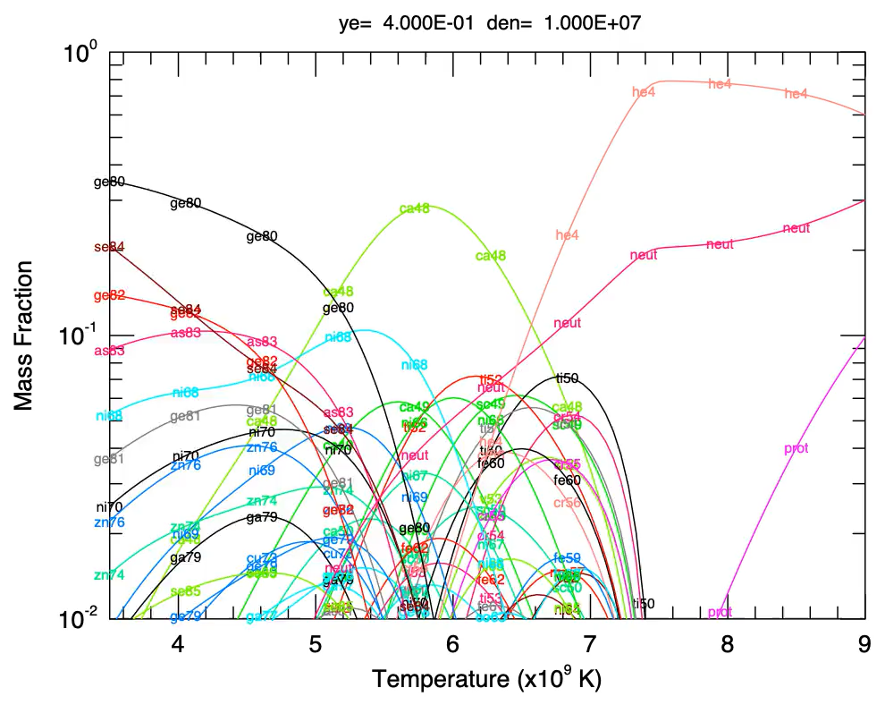
Late-stage capitalism nuclear burning
Frank Timmes website
Run out of sililcon
Temperature increases bring everything except weak rates into equilibrium
Nuclear Statistical Equilibrium
Abundances in NSE are given by temperature, density and neutron excess dependent upon nuclear properties
This “statistical” behaviour is confusing to me in a couple of ways
I’m used to building nuclei up like lego blocks
In NSE, reactions at higher masses can siphon material out of the statistically equilibrated region which can impact abundances of lighter nuclei

Slide 29
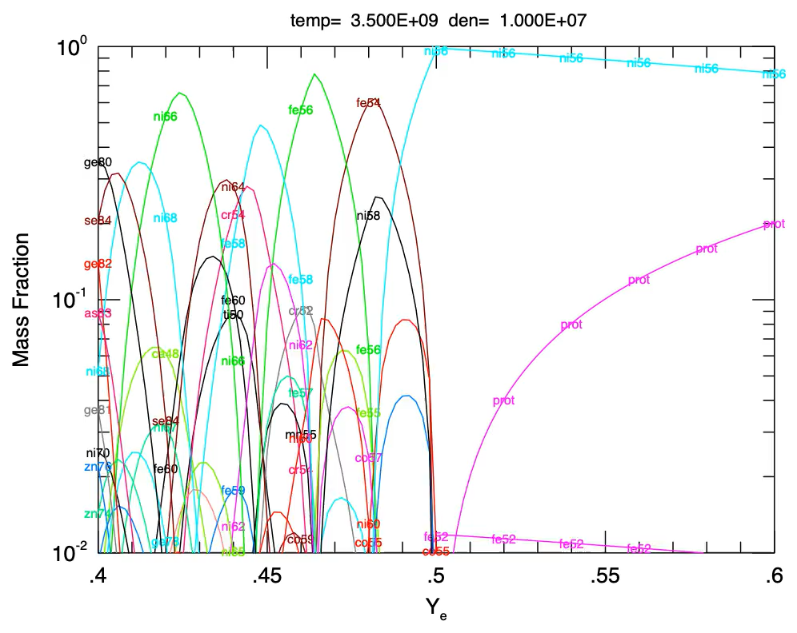
What do we make in NSE?
The basic rules for NSE
Mass is conserved
Neutron excess is mostly conserved
Statistical equilibrium so forward reaction = reverse reaction rate
The abundance of each isotope is determined by its nuclear properties (binding energy, mass, spin) and the abundances of free nucleons
Frank Timmes website

Slide 30

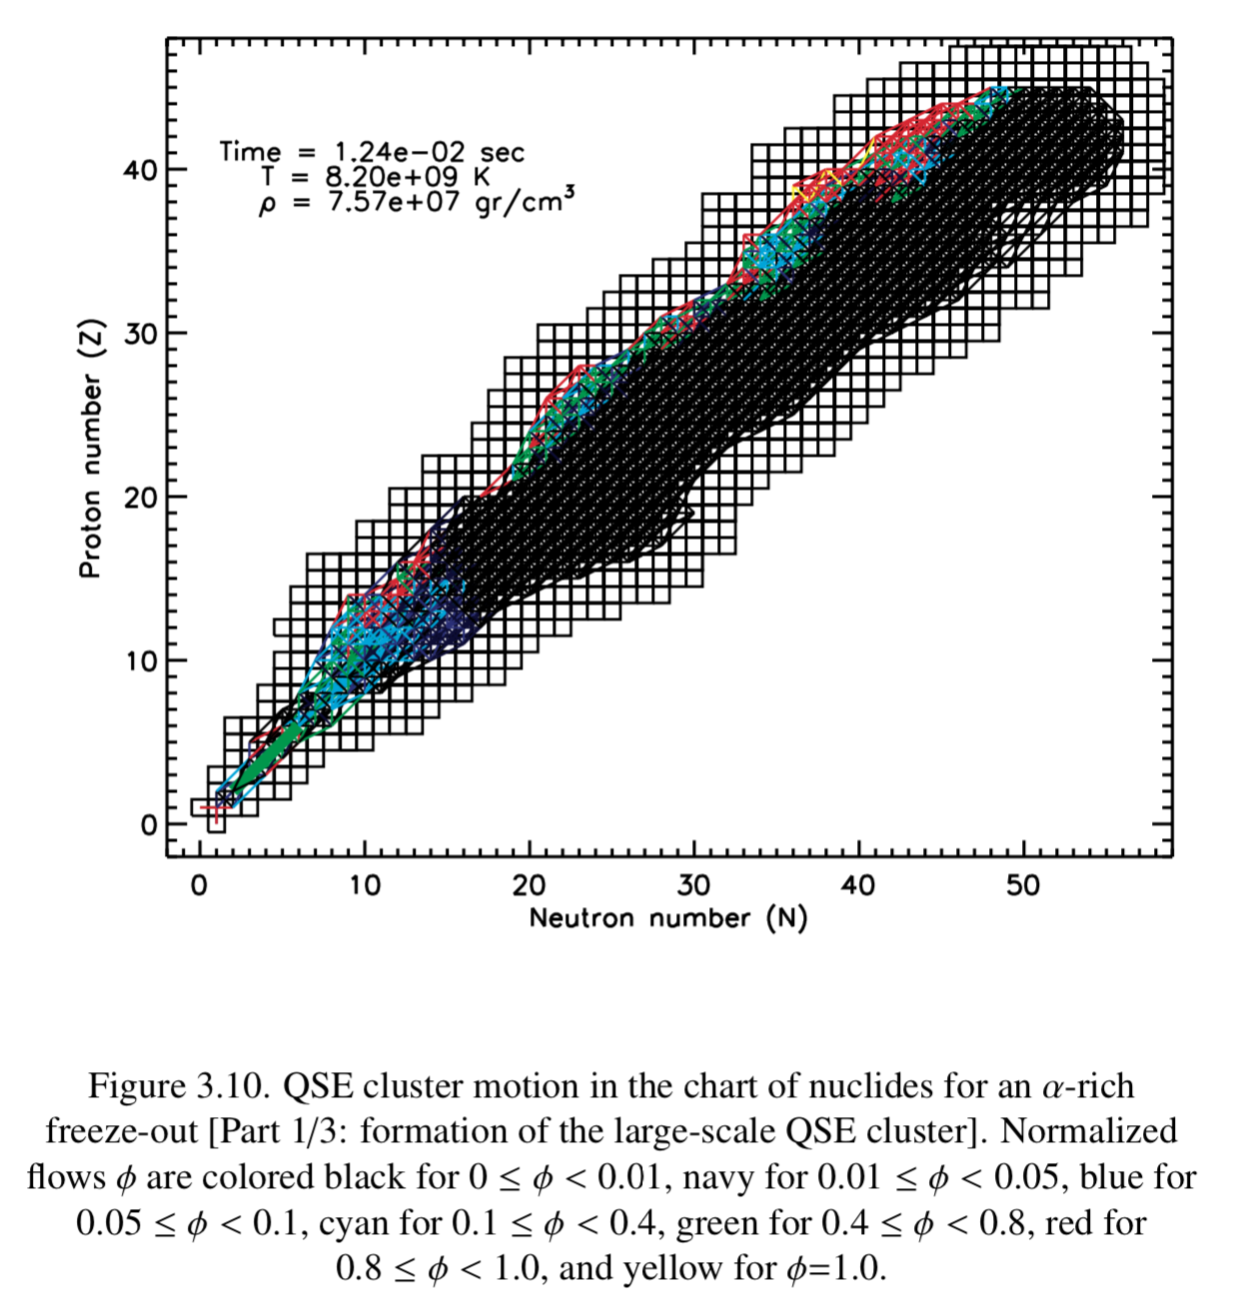


α-rich Freeze-out
Material expands and quasi-static equilibrium (QSE) is established
As expansion continues, nuclei fall out of equilibrium
When ⁴⁴Ti falls out of equilibrium, ⁵⁷Ni(p,𝛾)⁵⁸Cu controls the relative abundances within the cluster
Georgios Magkotsios, Nucleosynthesis During Freeze-out Expansions in Core-Collapse Supernovae, Dissertation, University of Notre Dame (2011)
Slide courtesy Scott Carmichael (ND)

Slide 31
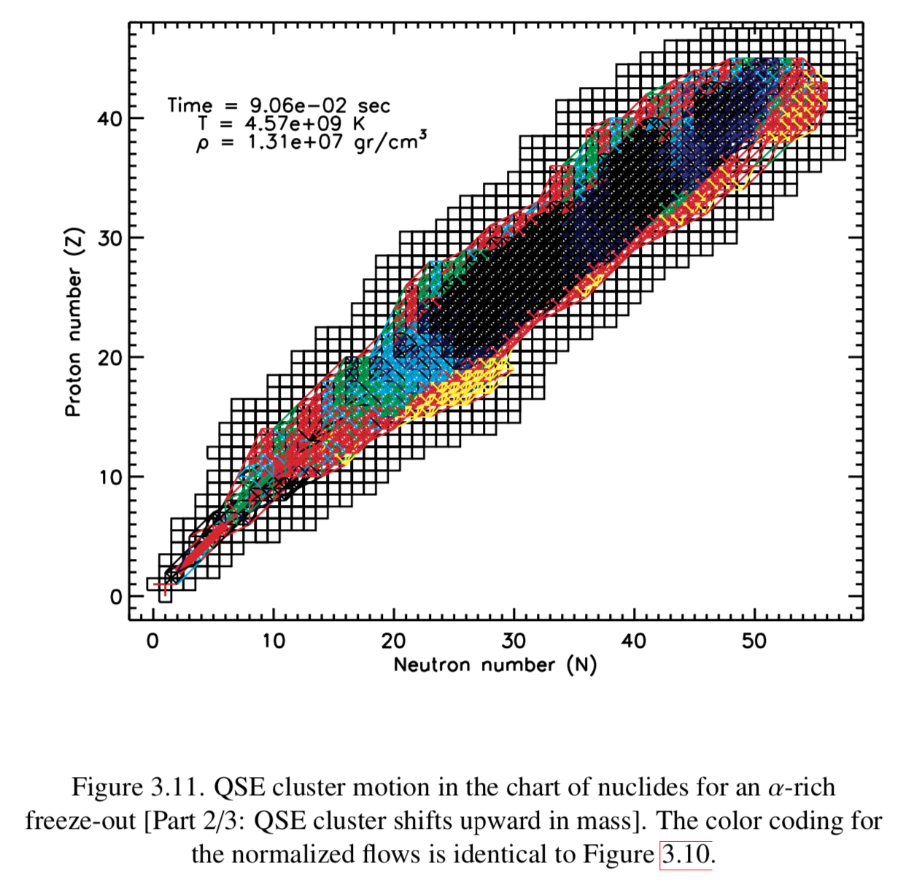
α-rich Freeze-out
Material expands and quasi-static equilibrium (QSE) is established
As expansion continues, nuclei fall out of equilibrium
When ⁴⁴Ti falls out of equilibrium, ⁵⁷Ni(p,𝛾)⁵⁸Cu controls the relative abundances within the cluster
Georgios Magkotsios, Nucleosynthesis During Freeze-out Expansions in Core-Collapse Supernovae, Dissertation, University of Notre Dame (2011)
Slide courtesy Scott Carmichael (ND)

Slide 32
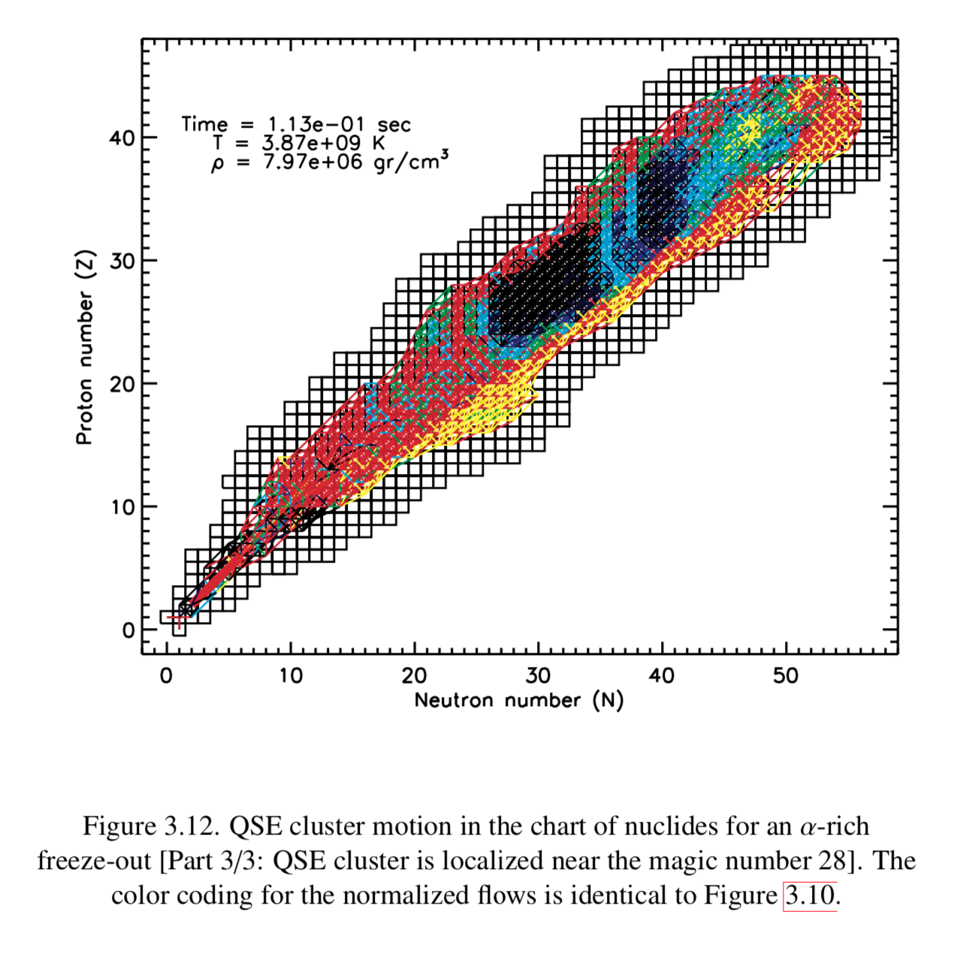
α-rich Freeze-out
Material expands and quasi-static equilibrium (QSE) is established
As expansion continues, nuclei fall out of equilibrium
When ⁴⁴Ti falls out of equilibrium, ⁵⁷Ni(p,𝛾)⁵⁸Cu controls the relative abundances within the cluster
Georgios Magkotsios, Nucleosynthesis During Freeze-out Expansions in Core-Collapse Supernovae, Dissertation, University of Notre Dame (2011)
Slide courtesy Scott Carmichael (ND)

Slide 33
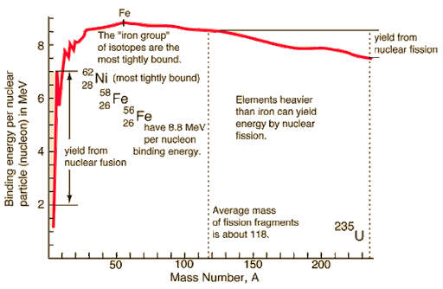
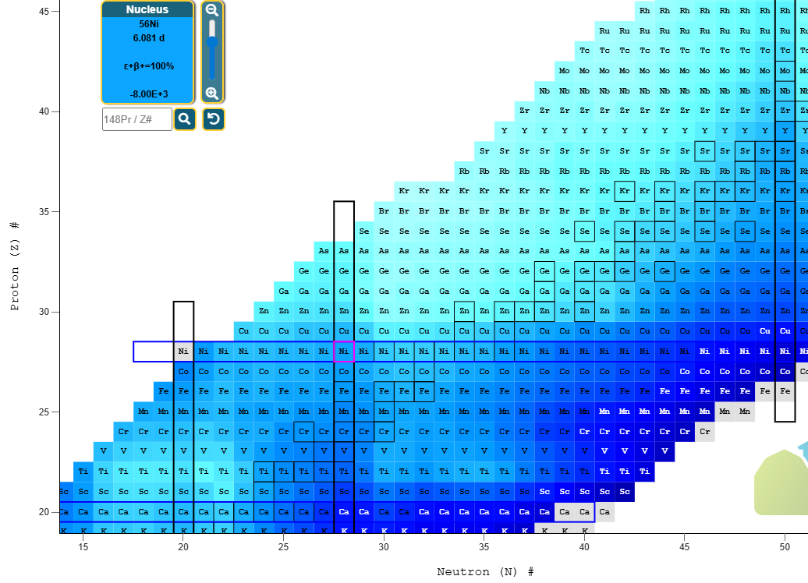
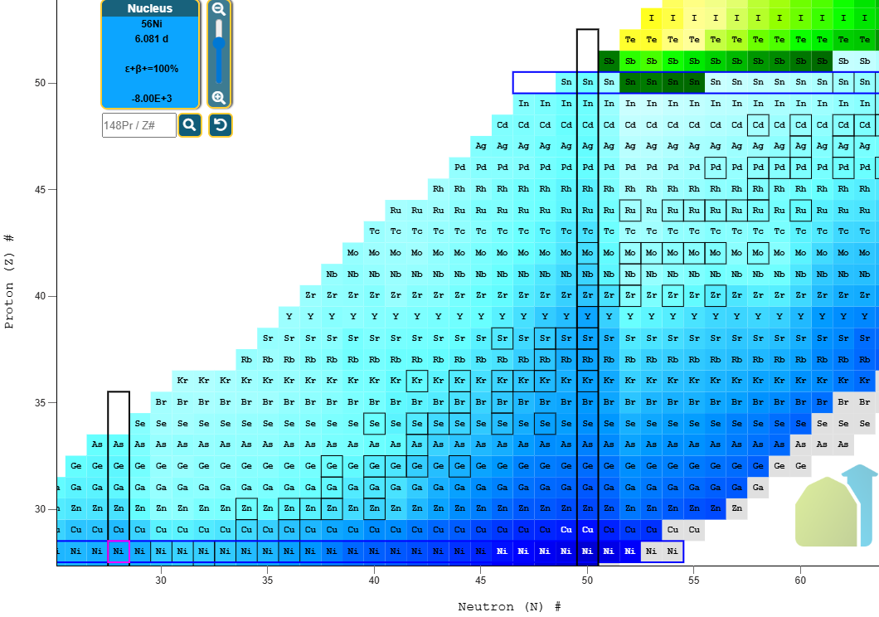
What have we managed to make?
All of that work has got our star up to iron – maybe traces of up to zinc
No more energy is generated after the iron peak because no more energy is generated in fusion
BE/A of compound system needs to exceed the BE/A of the components to support a star
Hyperphysics ☺

Slide 34
What have we managed to make?
The neutrinos are taking away most energy at this point – core contracts to make up this energy loss because nuclear processes can’t
Temperature rises are core contracts – photodisintegration of nuclei (endothermic process)
Losing more energy – more collapse!
Only stops when protons capture free electrons (also endothermic) and then neutron degenerate system in the core
Hyperphysics ☺

Slide 35
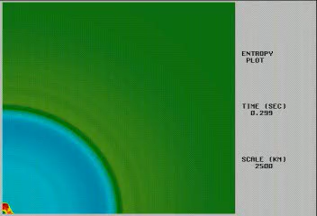
You fool, as if it matters how a star falls down?*
*approximately “The Lion In Winter” (1968) which won three Oscars btw
The neutrinos are taking away much of the energy at this point – core contracts to make up this energy loss because nuclear processes can’t
Temperature rises are core contracts – photodisintegration of nuclei (endothermic process)
Losing more energy – more collapse!
Only stops when protons capture free electrons (also endothermic) and then neutron degenerate system in the core
From JINAweb.org – hydrodynamic 2D simulation of explosion of massive star core, blue/green boundary is Si-O boundary infalling

Slide 36
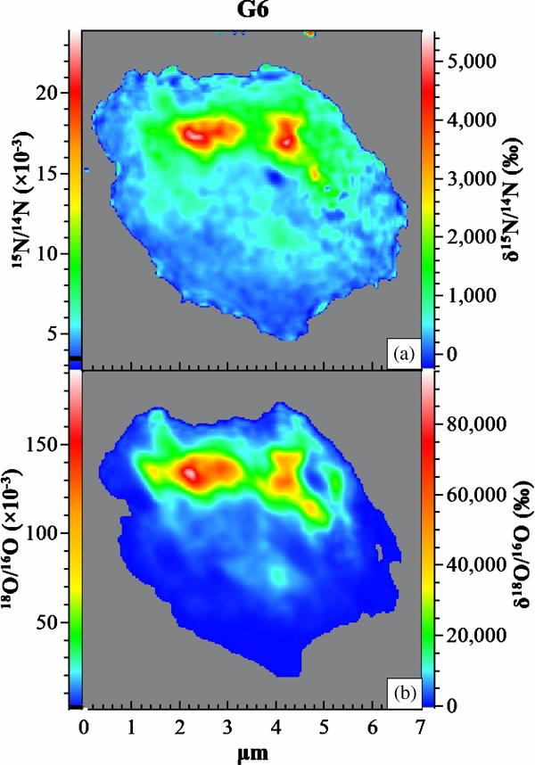
You fool, as if it matters how a star falls down?*
*approximately “The Lion In Winter” (1968) which won three Oscars btw
The infalling layers of the star “bounce” off the core (also neutrinos may transport some energy through the star)
Thermal pulse through the outer layers of the star cause many different reactions in different regions
He-shell, H-shell both have sudden nucleosynthesis events
Can e.g. result in ¹⁵N/¹⁸O production in the He-burning shell
Groopman++ ApJL 754 L8

Slide 37
You fool, as if it matters how a star falls down?*
*approximately “The Lion In Winter” (1968) which won three Oscars btw
The infalling layers of the star “bounce” off the core (also neutrinos may transport some energy through the star)
Thermal pulse through the outer layers of the star cause many different reactions in different regions
He-shell, H-shell both have sudden nucleosynthesis events
Can e.g. result in ¹⁵N/¹⁸O production in the He-burning shell
From JINAweb.org – hydrodynamic 2D simulation of explosion of massive star core, blue/green boundary is Si-O boundary infalling

Slide 38

Useful resources
I cannot recommend Frank Timmes’s website (cococubed.com) strongly enough
-Lots of educational material and MESA examples (think WinNet but harder)
Christian Iliadis’s textbook “Nuclear Physics of Stars” is a wonderful resource and includes a lot of example calculations which help with understanding networks
Tiffany Ard from Frank’s website

